Slide 1

Air Quality Dashboard
Fahad Shaikh
Jan 18, 2023

Slide 2
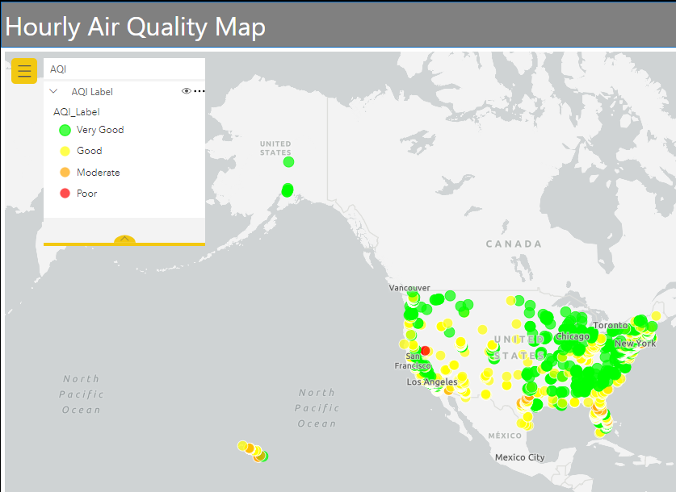
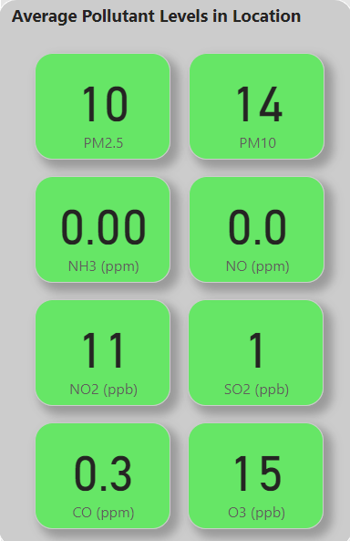
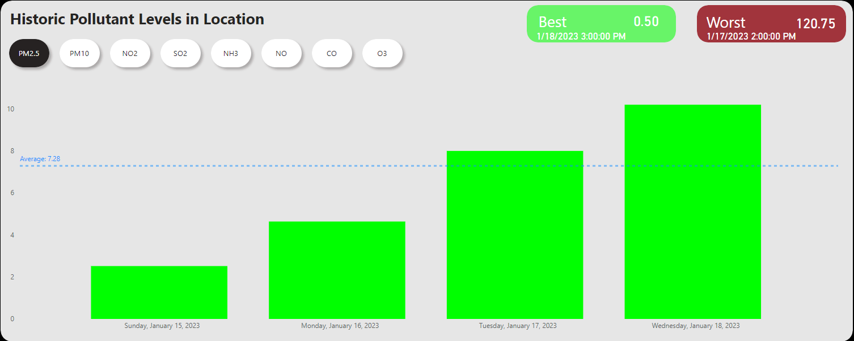








Project Outline
Motivation
Perspective
Exposure to air pollution is associated with 100k-200k deaths annually across the United States (Burnett et al., 2018)
Fine particulate matter (PM2.5) is known to cause cardiopulmonary and other systemic illnesses (Polezer et al., 2018)
Desired Outcomes
Develop a pipeline to automate the gathering of air pollution data
Visualize and monitor pollutant levels across all Tesla locations (excl. superchargers and parking lots)
Maintain current & historical air pollution database for predictive analysis
Data Flow
Hourly Scheduled
API
Data Lake
Wizards SQL
Power BI
Data Science + ML

Slide 3

What’s next?
Data Science
Data Modelling
Predictive Analytics
Machine Learning
Notification System

